Slide 1
A4 and A6
Group 8

Slide 2
A4 Classifying without Disparate Mistreatment
Goal: Use disparate mistreatment, a notion of unfairness which is defined in terms of misclassification rates, to build a fair classifier.
Steps:
Formalize notions of fairness
Convert constraints into convex form
Train decision boundary-based classifiers that do not suffer from disparate mistreatment by minimizing a convex loss.
Junhan Huang, Chenbohan Zhang, Xueyi Zhang

Slide 3
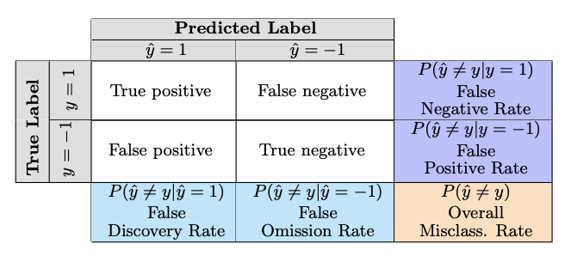
A4 Formalizing notions of fairness
A binary classifier does not suffer from disparate mistreatment if the misclassification rates for different groups of people having different values of the sensitive feature z are the same.
Misclassification rates can be measured as false positive and false negative rates.

Slide 4
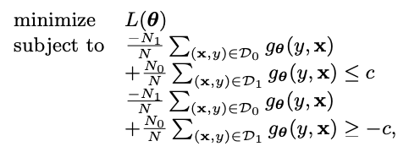
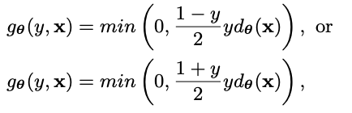
A4 Convert constraints into convex form
Propose an effective proxy for fairness: covariance between the users’ sensitive attributes and the signed distance between the feature vectors of misclassified users and the classifier decision boundary.
Convert constraints into a Disciplined Convex-Concave Program (DCCP).

Slide 5
A4 Train decision boundary-based classifiers
Train an unconstrained SVM classifier.
Train classifiers on data leads to disparate mistreatment in terms of only the false positive rate (fpr) or false negative rate (fnr).
Train classifiers on data leads to disparate mistreatment in terms of both fpr and fnr.

Slide 6
A4 Data
Input:
X: Features (DM: without sensitive feature; DM-sen: with sensitive feature)
Y: Label/result
Z: Sensitive feature
Data Preprocessing:
Remove columns from X if it contains significant amount of Null and Missing Data
Transform Y (labels) into {1,-1}
Transform and apply standard scaling to normalize values

Slide 7
A6 Handling Conditional Discrimination
Goal: train classifiers on a data set, so that they are discrimination free with respect to a given sensitive attribute, like RACE in this case.
Steps:
subroutine PARTITION (X, e)
subroutine DELTA (s)
perform algorithm: Local massaging (LM) & Local preferential sampling (LPS)
Liang Hu, Wenchang Zhu
Notes:
subroutine PARTITION (X, e): divide data points from different races to different groups
subroutine DELTA (s): introduce later

Slide 8
A6 Handling Conditional Discrimination
Input:
X – an instance in p dimensional space
s – sensitive attribute
e – explanatory attribute
y – label/result
How to select features?
First drop missing values
Then use a heatmap to filter out the most popular features among all variables ( category correlation)

Slide 9
A6: algorithm - delta Function
Performs a fairness or bias mitigation operation on the data
based on an individual's race and their predicted probability of re-offending；
by updating the predicted label which falls within a certain threshold for two-year recidivism rate.
ALSO, DELTA function is the main difference to reduce discrimination
LM: relabel
LPS: delete/duplicate ½ data
Notes:
What is the threshold?
p_star = (rate_af+rate_ca)/2 # Equation 4
threshold = np.abs(rate_af-p_star)
LM LPS
Race 1: order from + to - delete ½ +, duplicate ½ -
Race 2: order from - to + delete ½ -, duplicate ½ +

Slide 10
A6: algorithm - LM & LPS
Result: P ′(+|m, ei) = P ′(+|f, ei) = P ⋆ (+|ei )
LM: a message-passing algorithm, passing messages between nodes and factors in a local manner based on certain rule.
For every partition in the training data, modify labels (1 or 0)
LPS: a network growth model, generating synthetic networks by selecting new nodes if their degree is higher than their neighbors’ degree.
Modify the composition of the training set. It deletes and duplicates ½ training instances according to the threshold
Notes:
Small bullet points are exactly what a DELTA function do

Slide 11
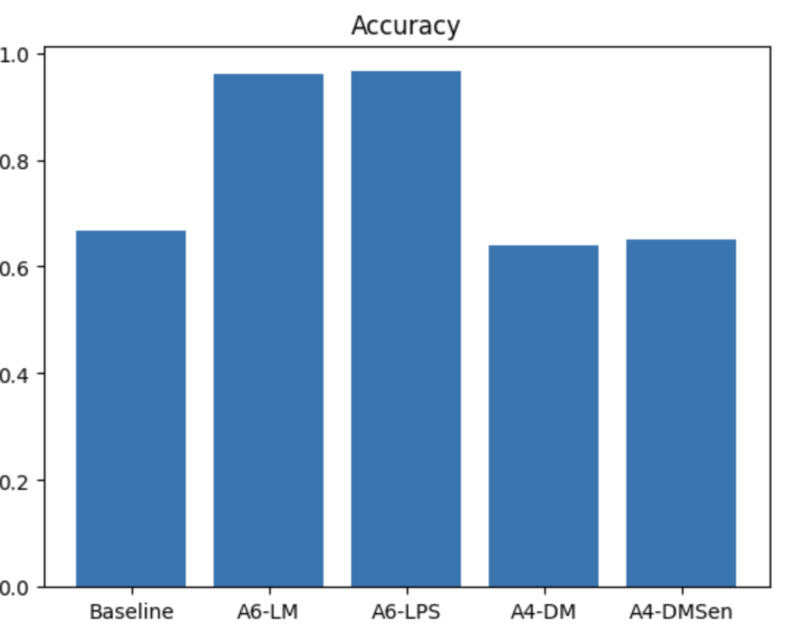
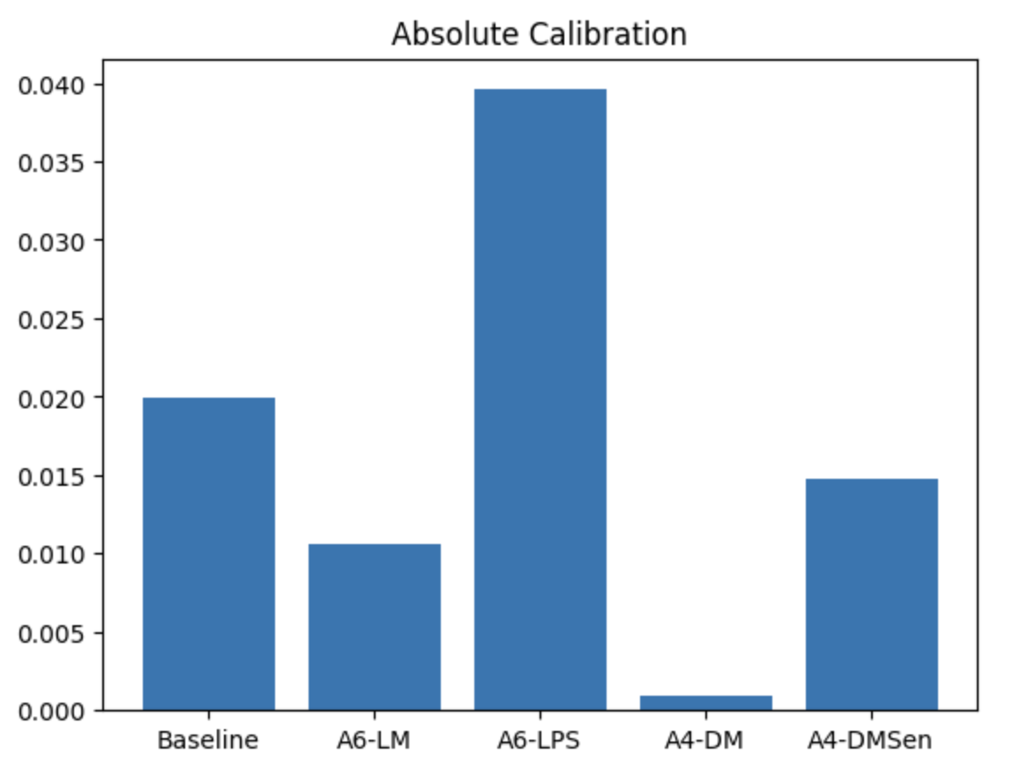
Diagram

Slide 12
Comparison
What do they mean?
 | Baseline | LM - A6 | LPS - A6 | DM - A4 | DM-sen - A4
Calibration (African American and Caucasian) | 0.0199 | 0.01059 | 0.03958 | 0.014240 | 0.031734
Accuracy | 0.66612 | 0.96098 | 0.96531 | 0.639837 | 0.6627
F1-score | 0.62446 | 0.96461 | 0.96733 | 0.88 | 0.69207
Recall-score | 0.57816 | 0.97363 | 0.95658 | 0.713043 | 0.6811
Notes:
Recall measures the ability of the model to correctly identify positive instances, while F1 score is a summary metric that takes into account both precision and recall to provide an overall measure of the model's performance.
We plotted accuracy, absolute calibration, F1, and recall for all five models as above.
- 1) LM and LPS have the similar highest accuracy while baseline and DM-sen have the similar lowest accuracy;
- 2) LM has the lowest caliberation while LPS has the highest caliberation;
- 3) LM and LPS have the similar highest F1-score;
- 4) LM has the highest recall-score.
In summary, the overall performance of A6 is better than A4. For accuracy, F1, and recall, A6-LM and A6-LPS are almost equally competitive in removing bias of sensitive attribute like race. According to calibration, A6-LM performs better than A6-LPS because of relabel algorithm.
A4:
DM can avoid disparate treatment and disparate mistreatment simultaneously.
DM sen can only avoid disparate mistreatment
FNR difference 0.255086->0.099326
FPR difference 0.241346->0.087500

